Slide 1


2017 FIRST AID MEETING
APRIL 18, 2017

Slide 2

BY STANDER FIRST AID
Collisions
When two players collide into each other access for injuries.
-If one or more players are unresponsive DO NOT MOVE and SIGNAL FOR PARK POLICE/MFLL BOARD MEMBER
-If players show signs of a concussion follow the concussion protocol
-If bleeding perform bleeding control methods, Direct pressure
-If the Arm has obvious fracture and the player is unable to stand hold gentle traction.
-If leg or anything below the stomach causes the player extreme pain do not move the player.

Slide 3
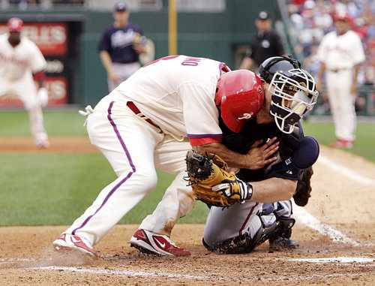
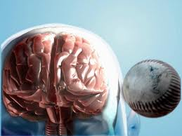
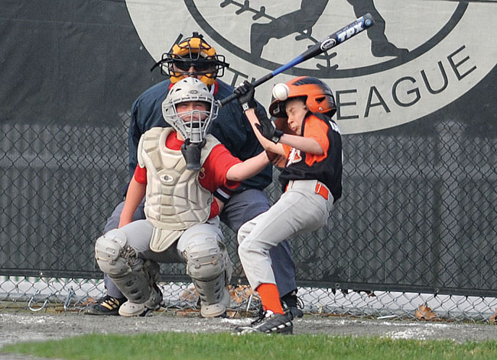
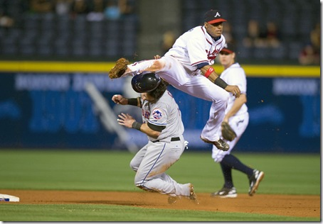
Concussions
  CDC HEADS UP PROGRAM

Slide 4
Concussions
  CDC HEADS UP PROGRAM
    REQUIRED FOR ALL MANAGERS/COACHES
    ALL CDC CONCUSSION CERTIFICATES MUST BE TURNED INTO PLAYER AGENTS
      BY OPENING DAY
  IMPACT
    ALL FIRST AID KITS HAVE A IMPACT CONCUSSION CARD
      SIMPLE QUESTIONS
      SIGNS AND SYMPTOMS OF CONCUSSION
  WHEN IN DOUBT---SIT THEM OUT

Slide 5
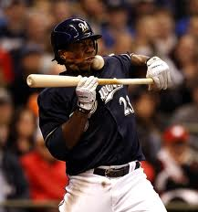
BY STANDER FIRST AID
HIT IN THE FACE WITH THE BALL
If a player is struck in the face by a ball access for injuries if player has severe tenderness in any of the facial region the player may have to be removed from the game and taken in for X-rays to rule out any facial fractures. Pitchers are in direct line for this injury so also access for concussions as well.

Slide 6
BY STANDER FIRST AID
Commotio Cordis ("agitation of the heart") is an often lethal disruption of heart rhythm that occurs as a result of a blow to the area directly over the heart (the precordial region), at a critical time during the cycle of a heart beat causing cardiac arrest. It is a form of ventricular fibrillation (V-Fib), not mechanical damage to the heart muscle or surrounding organs, and not the result of heart disease. The fatality rate is about 65%. It can sometimes, but not always, be reversed by defibrillation.
Commotio cordis occurs mostly in boys and young men (average age 15), usually during sports, most often baseball, often despite a chest protector. It is most often caused by a projectile, but can also be caused by the blow of an elbow or other body part. Being less developed, the thorax of an adolescent is likely more prone to this injury given the circumstances.

Slide 7
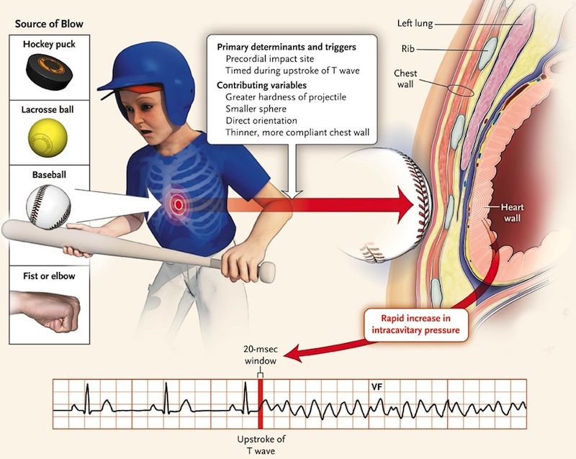

BY STANDER FIRST AID
Commotio Cordis ("agitation of the heart")

Slide 8
BY STANDER FIRST AID
STRAINS, SPRAINS, AND FRACTURES
  If a player shows signs of a one of the above treat accordingly. If a player is unable to move don’t move them this may do more arm. Activate MFLL EMS PLAN. If a player has an injury to the hand such as dislocation of the finger ETC do not move the digit notify the parents right away and have child taken to the local ER or Primary Physician.

Slide 9
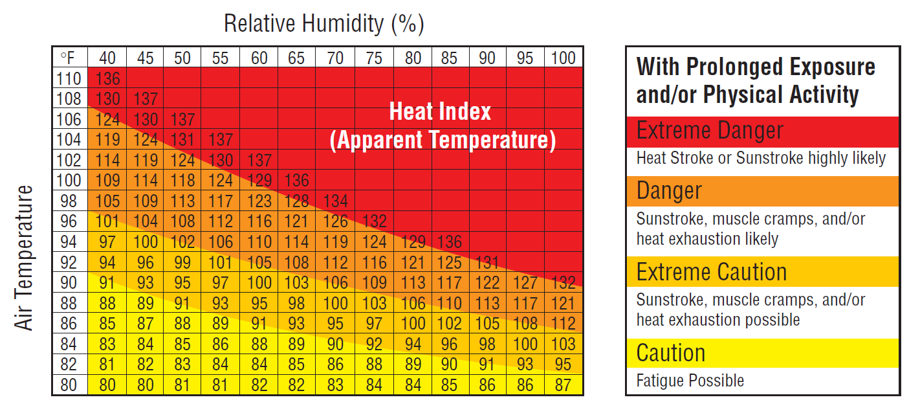
BY STANDER FIRST AID
HEAT AND HUMIDITY

Slide 10
BY STANDER FIRST AID
Heat cramps are the earliest symptoms of the spectrum of heat-related illness. There is usually significant sweating with involuntary spasm of the large muscles in the body. The muscles that cramp are usually those that have been stressed. Heat cramps usually begin after significant activity has occurred, but they also can occur hours after the activity has been completed.
TREATMENTS Rest briefly and cool down
Drink clear juice or an electrolyte-containing sports drink
Practice gentle, range-of-motion stretching and gentle massage of the affected muscle group

Slide 11
BY STANDER FIRST AID
HEAT EXHAUSTION
  is a condition whose symptoms may include heavy sweating and a rapid pulse, a result of your body overheating. It's one of three heat-related syndromes, with heat cramps being the mildest and heatstroke being the most severe.
Causes of heat exhaustion include exposure to high temperatures, particularly when combined with high humidity, and strenuous physical activity. Without prompt treatment, heat exhaustion can lead to heatstroke, a life-threatening condition. Fortunately, heat exhaustion is preventable.

Slide 12
BY STANDER FIRST AID
HEAT EXHAUSTION
Signs and symptoms of heat exhaustion may develop suddenly or over time, especially with prolonged periods of exercise. Possible heat exhaustion signs and symptoms include:
  Cool, moist skin with goose bumps when in the heat
  Heavy sweating
  Faintness
  Dizziness
  Fatigue
  Weak, rapid pulse
  Low blood pressure upon standing
  Muscle cramps
  Nausea
  Headache

Slide 13
BY STANDER FIRST AID
HEAT EXHAUSTION
Treatments
In most cases, you can treat heat exhaustion yourself by doing the following:
Rest in a cool place. Getting into an air-conditioned building is best, but at the very least, find a shady spot or sit in front of a fan. Rest on your back with your legs elevated higher than your heart level.
Drink cool fluids. Stick to water or sports drinks. Don't drink any alcoholic beverages, which can contribute to dehydration.
Try cooling measures. If possible, take a cool shower, soak in a cool bath or put towels soaked in cool water on your skin.
Loosen clothing. Remove any unnecessary clothing and make sure your clothes are lightweight and nonbinding.
If you don't begin to feel better within one hour of using these treatment measures, seek prompt medical attention. You may be given intravenous (IV) fluids to help you rehydrate. Immersing yourself in cold water, misting your skin, placing yourself in front of fans, or using cold or ice packs and cooling blankets are some of the techniques that may be used to bring down your body temperature.

Slide 14
BY STANDER FIRST AID
HEAT STROKE
HEAT STROKE is a condition caused by your body overheating, usually as a result of prolonged exposure to or physical exertion in high temperatures. This most serious form of heat injury, heatstroke can occur if your body temperature rises to 104 F (40 C) or higher.
Heatstroke requires emergency treatment. Untreated heatstroke can quickly damage your brain, heart, kidneys and muscles. The damage worsens the longer treatment is delayed, increasing your risk of serious complications or death.

Slide 15
BY STANDER FIRST AID
HEAT STROKE
  High body temperature. A body temperature of 104 F (40 C) or higher is the main sign of heatstroke.
  Altered mental state or behavior. Confusion, agitation, slurred speech, irritability, delirium, seizures and coma can all result from heatstroke.
  Alteration in sweating. In heatstroke brought on by hot weather, your skin will feel hot and dry to the touch. However, in heatstroke brought on by strenuous exercise, your skin may feel moist.
  Nausea and vomiting. You may feel sick to your stomach or vomit.
  Flushed skin. Your skin may turn red as your body temperature increases.
  Rapid breathing. Your breathing may become rapid and shallow.
  Racing heart rate. Your pulse may significantly increase because heat stress places a tremendous burden on your heart to help cool your body.
  Headache. Your head may throb.
TREATMENTS
  If you think a person may be experiencing heatstroke, seek immediate medical help, SIGNAL FOR BOARD MEMBER/PARK POLICE. Call 911 or your local emergency services number.
  Take immediate action to cool the overheated person while waiting for emergency treatment.
  Get the person into shade or indoors.
  Remove excess clothing.

Slide 16
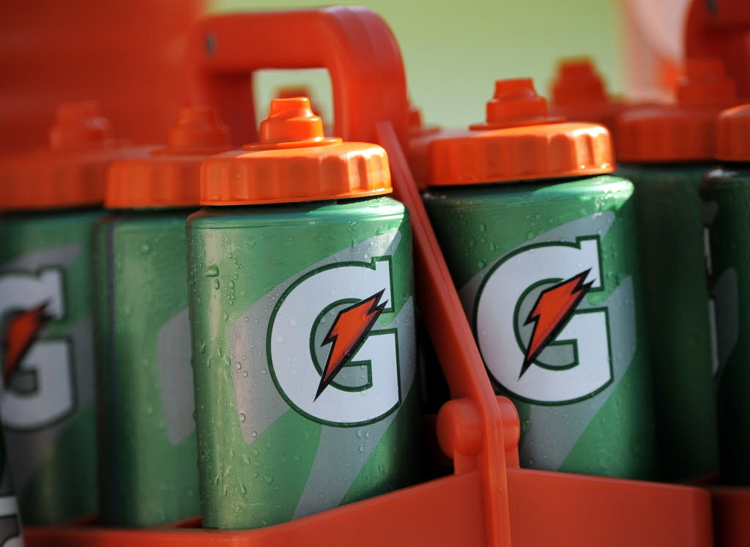
HYDRATION
Hydration
  All managers and/or coaches must review the heat & humidity danger handout. This is on the website.
  Drink 8-12 oz. each 30-45 min.
  Replace fluids 16 oz. for each pound lost from exercise
  Check urine color after exercise
    Clear is better
    Darker is worse

Slide 17
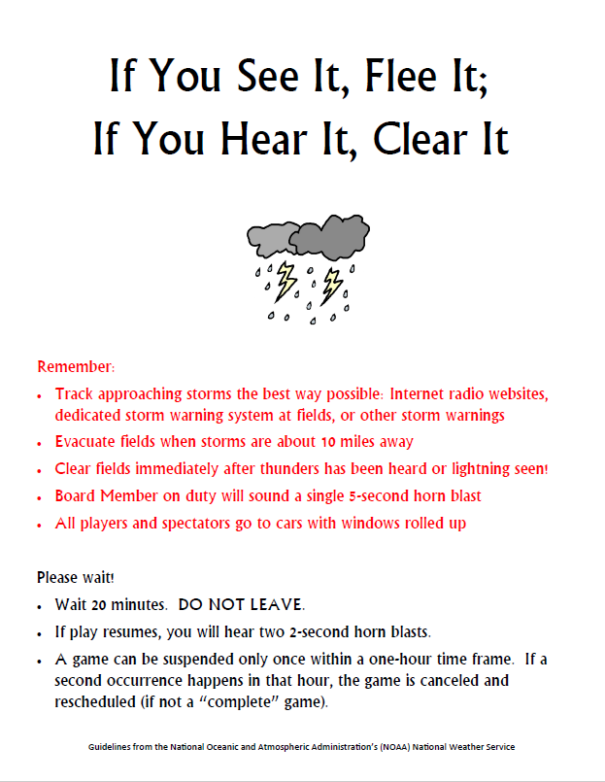
THUNDER & LIGHTNING
Policy

Slide 18
BLOOD BORNE PATHOGEN PLAN
BLOOD AND ANY OTHER POTENTIALLY INFECTIOUS MATERIALS CAN BE DANGEROUS
EACH FIRST AID KIT HAS GLOVES AND BIOHAZARD BAG (RED)
  MFLL HAS BIOHAZARD CONTAINERS IN EACH CONCESSION STAND
BLOOD ON UNIFORM
  BLOOD BUSTER
BLOOD ON BASES & HOME PLATE
  CAVICIDE XL WIPES
ALL BBP SUPPLIES WILL BE IN THE SHED’S IN BETWEEN FIELDS
  LABELED IN KITS

Slide 19
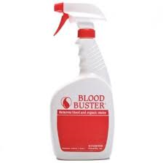
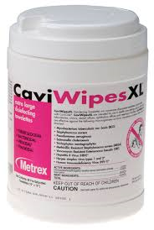
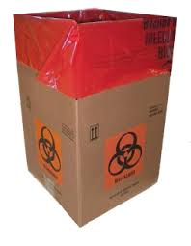
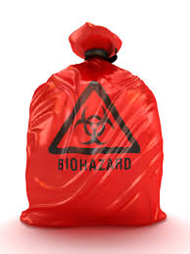
BLOOD BORNE PATHOGEN PLAN
UNIFORM SURFACE CLEANER

Slide 20
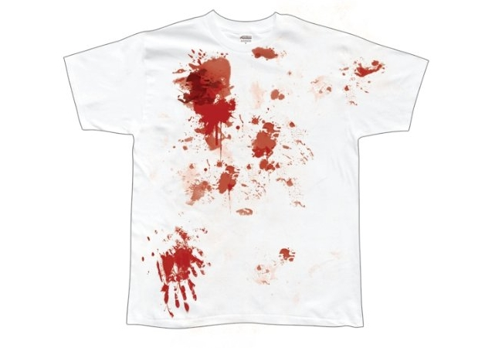
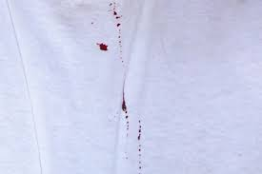
BLOOD BORNE PATHOGEN PLAN

Slide 21
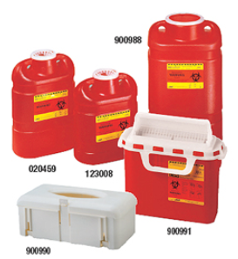
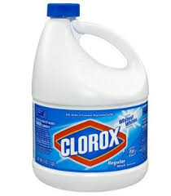
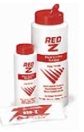
BLOOD BORNE PATHOGEN PLAN
  BLEACH/WATER SHARPS CONTAINERS
  FLUID CONTROL SOLIDIFIER

Slide 22

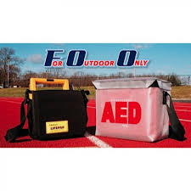
AED PLAN
MFLL HAS THREE (4) AED’S
  UPPER CONCESSION STAND
  LOWER CONCESSION STAND
  SOFTBALL FIELD (IN CABINET)
  PARK POLICE CART

Slide 23
EMS PLAN
In the event of an Emergency, please locat
e the nearest MFLL Board Member and/or Park
Police personnel to inform of the Emergency. The MFLL Board Member and/or Park
Police personnel will implement the second phase of the EMS Plan.
1.
MFLL has eight (8) radios of which the following will have access to:
to:
a.
Upper concession stand
b.
Lower concession stand
c.
Park police cart driver
d.
Softball upper field
e.
Two (2) Board Members on site at any given time
2.
MFLL Park Police on duty will contact 911 to implement the EMS plan
MFLL Board Member and/or Park Police
personnel will do the following:
1.
Send an individual at the main gate to greet EMS
in a cart
2.
Send an Individual to the scene of the accident, injury or condition
3.
Send an individual to retrieve the AED

Slide 24
EMS PLAN
Every MFLL Board Member:
  CPR/AED and BYSTANDER FIRST AID CERTIFIED
  ALL MFLL BOARD MEMBERS KNOW AND UNDERSTAND THE EMS PLAN
ALL MANGERS/COACHES
  PLEASE REFER ALL MEDICAL EMERGENCIES TO PARK POLICE
  BE OF ASSISTANCE TO THE MFLL BOARD MEMBER/PARK POLICE

Slide 25
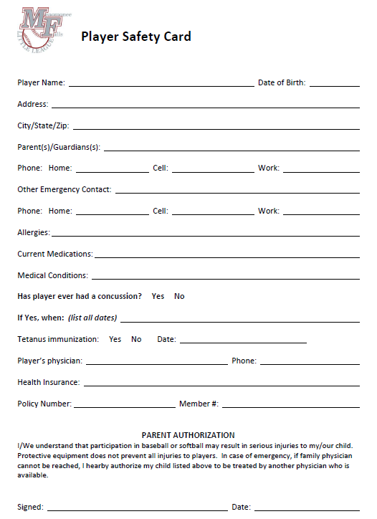
SAFETY CARDS
The Safety Cards were filled out on line and will be distributed to the coaches

Slide 26
SAFETY CARDS
MANAGERS/COACHES
  ALLERGIES OF PLAYERS
    PEANUTS
    BEE STINGS
    MEDICATIONS
  MEDICAL CONDITIONS
    DIABETIC
    ASTHMA
ANY MEDICATION NEEDS TO BE DISPENSED BY PARENTS/PLAYERS

Slide 27
REPORTING OF INJURIES

Slide 28
REPORTING OF INJURIES
Process:
All injuries will be documented on the Little League Baseball & Softball Accident Notification Form
The Little League Baseball & Softball Accident Notification Form are located in each team’s first aid kit and additional forms are on MFLL web site as well as the upper/lower concession stands in the supplemental first aid kits
The completed Little League Baseball & Softball Accident Notification Form will be submitted within 48 hours of the incident. The Safety Officer will be the procurer of the injury forms. The forms will be collected from the “mailbox” located at the MFLL complex on a daily basis.
Please make sure that the parents/players information is on the form with contact information
Coaches: Ensure that the form is completely filled out prior to submission
The coach or league official will also notify the safety officer when the incident occurs either by phone or by email. The contact information is below:
  Safety Officer: Roger Caplinger, ATC/L
    414-688-7178 (cell)
    Roger.caplinger@brewers.com (email)
A copy of the Little League Baseball & Softball Accident Report will be forwarded to the Little League International Headquarters within 20 days after the accident per form instructions, by the MFLL Safety Officer
The Safety Officer will input the injury into the injury surveillance system (MFLL) and follow up with parents within 24 hours after the Little League Baseball & Softball Accident Report is received.

Slide 29
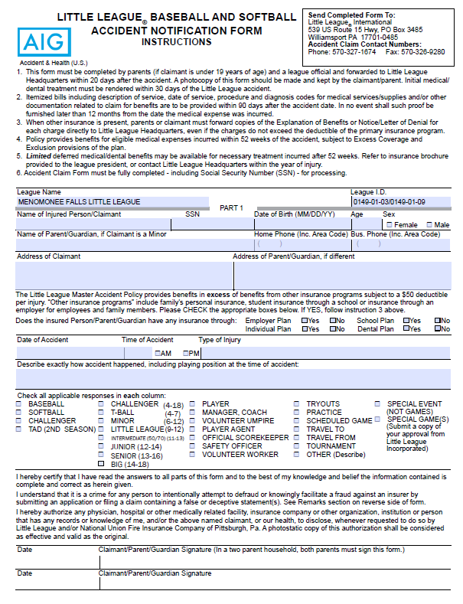
REPORTING OF INJURIES
  ACCIDENT CLAIM FORM
    PAGE 1

Slide 30
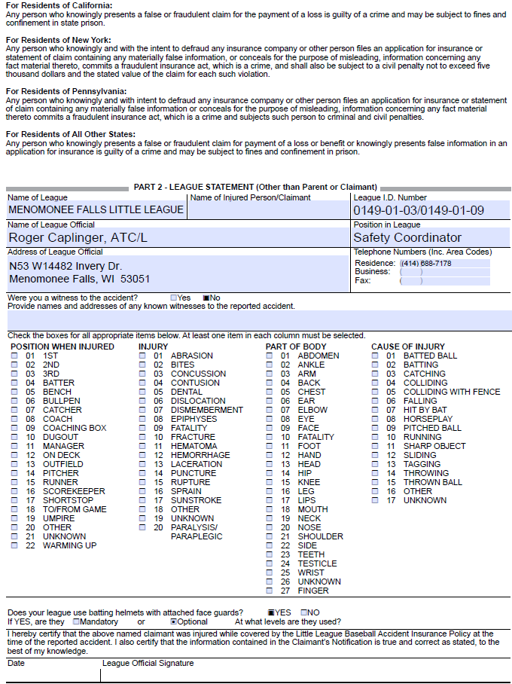
REPORTING OF INJURIES
  ACCIDENT CLAIM FORM
    PAGE 2

Slide 31
INJURIES
  2007-PRESENT LITTLE LEAGUE INTERNATIONAL
    PITCH COUNTS DECLINE IN INJURIES BY 30%
  2016
    HIGH SCHOOL PLAYERS (PITCHERS) MAKE UP 18% OF ALL ELBOW RECONSTRUCTIONS
    THESE OUTNUMBER PROFESSIONAL PITCHERS
  LITTLE LEAGUE AGE CHILDREN
    44% HEAD INJURIES (INCLUDING CONCUSSIONS)
    Upper Extremity Injuries
      13% Wrist/Hand Fingers
      31% Elbow/Shoulder
    Lower Extremity
      5% Knees, 6% Ankles
    American Academy of Pediatrics March 2015 vol. 129/Is. 3

Slide 32
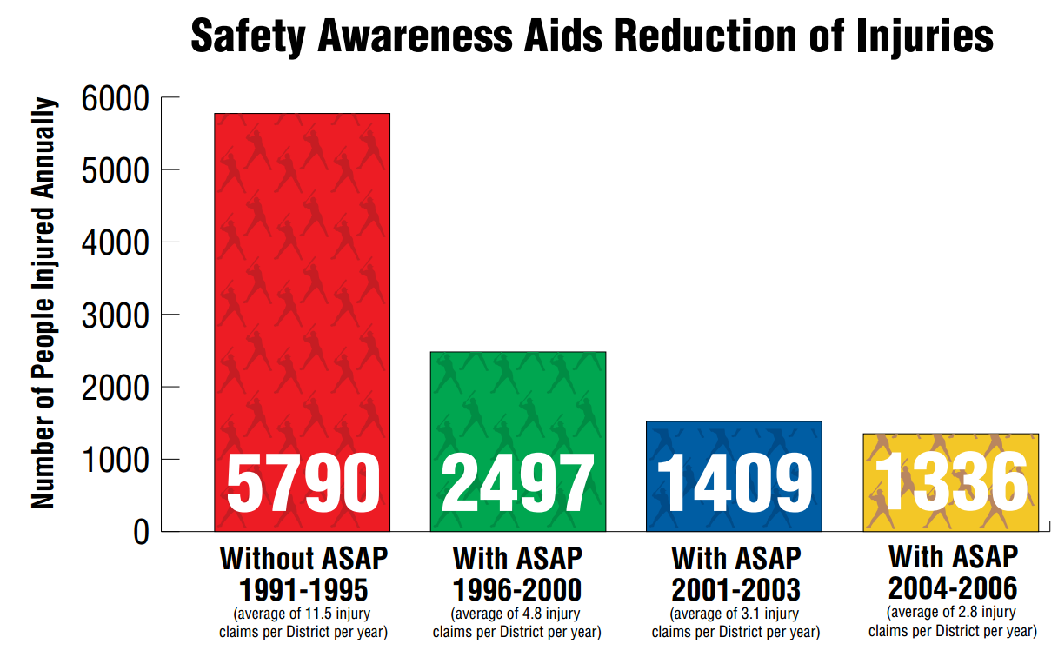
INJURIES

Slide 33
FIRST AID KITS
First Aid Kits
  All MFLL First Aid kits have brand new supplies
  All MFLL First Aid Kits are identical
  MFLL First Aid kits have safety cards, Little League Baseball & Softball Accident Forms, ImPACT Concussion Cards.
  If any manager and/or coach needs additional supplies, it will be his or her responsibility to replenish the first aid kit by going to either the upper or lower concession stand. An auxiliary first aid kit will be available with all items necessary.
  Ice Packs
  Each MFLL First Aid Kit will have TWO (2) ice packs. Please use these for athletic injuries. These are not designed for heat illness, but can be in the event of an emergency.

Slide 34
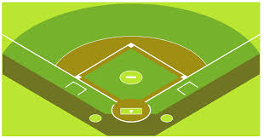
SURVEY THE FIELD
Survey the Field
  All managers and/or coaches need to survey the field prior to any game or practice.
  Please ensure that the playing surface and surrounding areas are safe for players, managers, coaches and spectators.

Slide 35
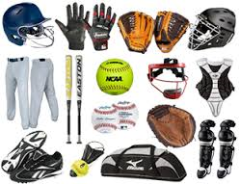
EQUIPMENT
Equipment
  All managers and/or coaches are required to inspect all equipment provided by the MFLL
  Ensure that all equipment is not damaged and is in good working order
  If equipment is damaged, please DO NOT allow to be used during practice and games
  Notify the MFLL equipment managers for repair and/or replacement

Slide 36
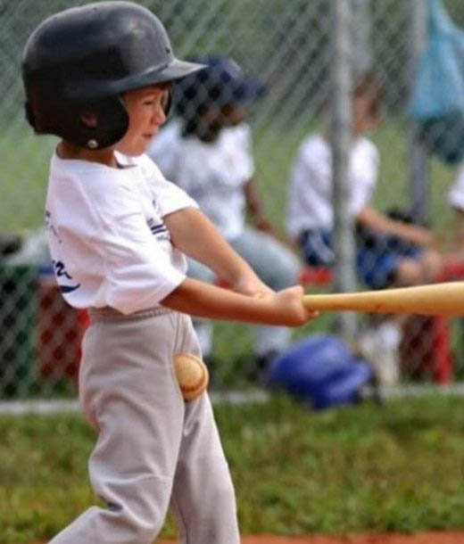
EQUIPMENT
Equipment

Slide 37
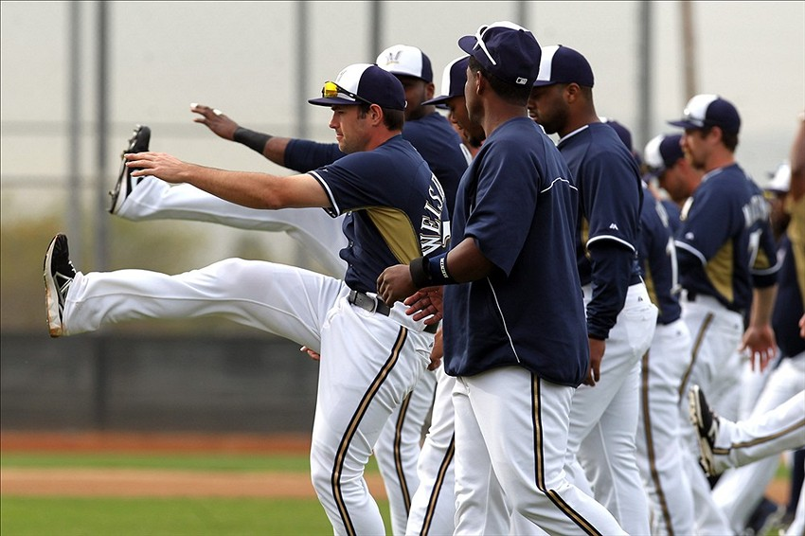
MFLL WARM UP PROGRAM
  PLEASE SEE THE MFLL WARM UP ROUTINE ON THE WEB SITE

Slide 38
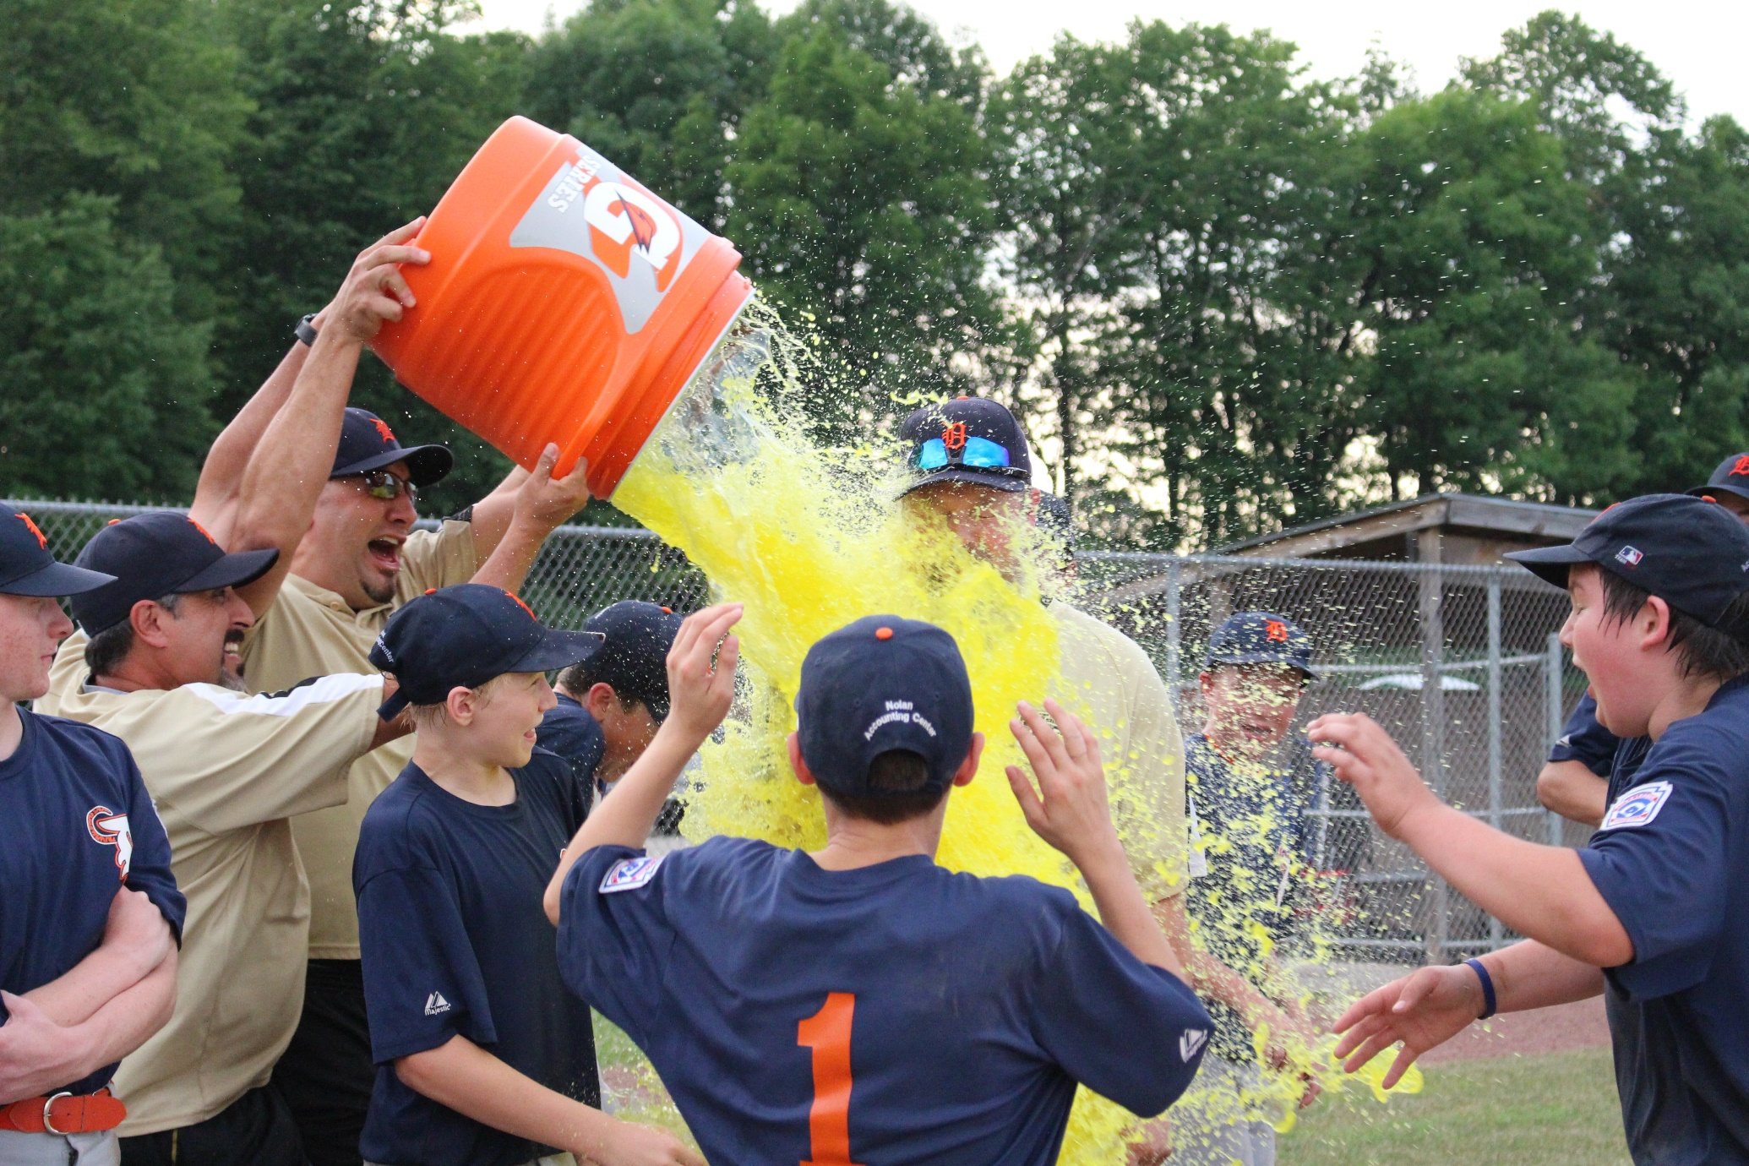
LET’S ALL HAVE FUN!!!!!!!!!!

